Slide 1
KPI Predictor for Professional Soccer Players
Giacomo Radaelli

Slide 2
Appendix
01
02
03
04
05
06
Problem
Data Collection
Data Preprocessing
What is the overarching problem for this project?
How was the data collected?
What preprocessing was done to prepare the data?
Model Selection
SHAP Analysis
Future Work
Which models worked best?
Which features were most influential?
How can we improve this analysis?

Slide 3
Problem Statement
When predicting the key performance indicator (KPI) for professional soccer players, what are the most impactful features?
3 position groups (Forwards, Midfielders, Defenders)
1 KPI per group (SoT/90, KP/90, TklW/90)
Data from 2020, 2021, and 2022 seasons
Goal: Predict KPIs for 2023 season and identify most influential features.

Slide 4


Data Collection
Used Kaggle dataset for player information (Age, birth month, preferred foot, club, nationality)
Wrote a script to scrape three seasons of in-game statistics from Fbref.com

Slide 5
Data Preprocessing
Merged player information with in-game statistics data
Removed duplicate players
Concatenated 2020 and 2021 seasons into same dataset
Same for 2021 and 2022
Converted total count features to “/90”
Ex: Gls -> Gls/(total 90s played)
20/10.3 = 1.94
Select KPI features (SoT/90, KP/90, TklW/90)
Target encoder for categorical features
StandardScaler

Slide 6
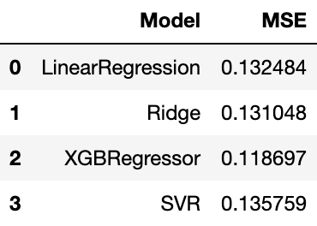
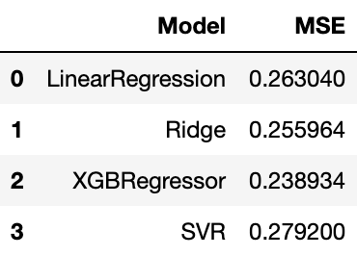
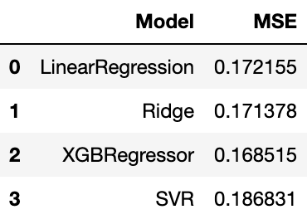
Model Selection
Attackers
Midfielders
Defenders

Slide 7
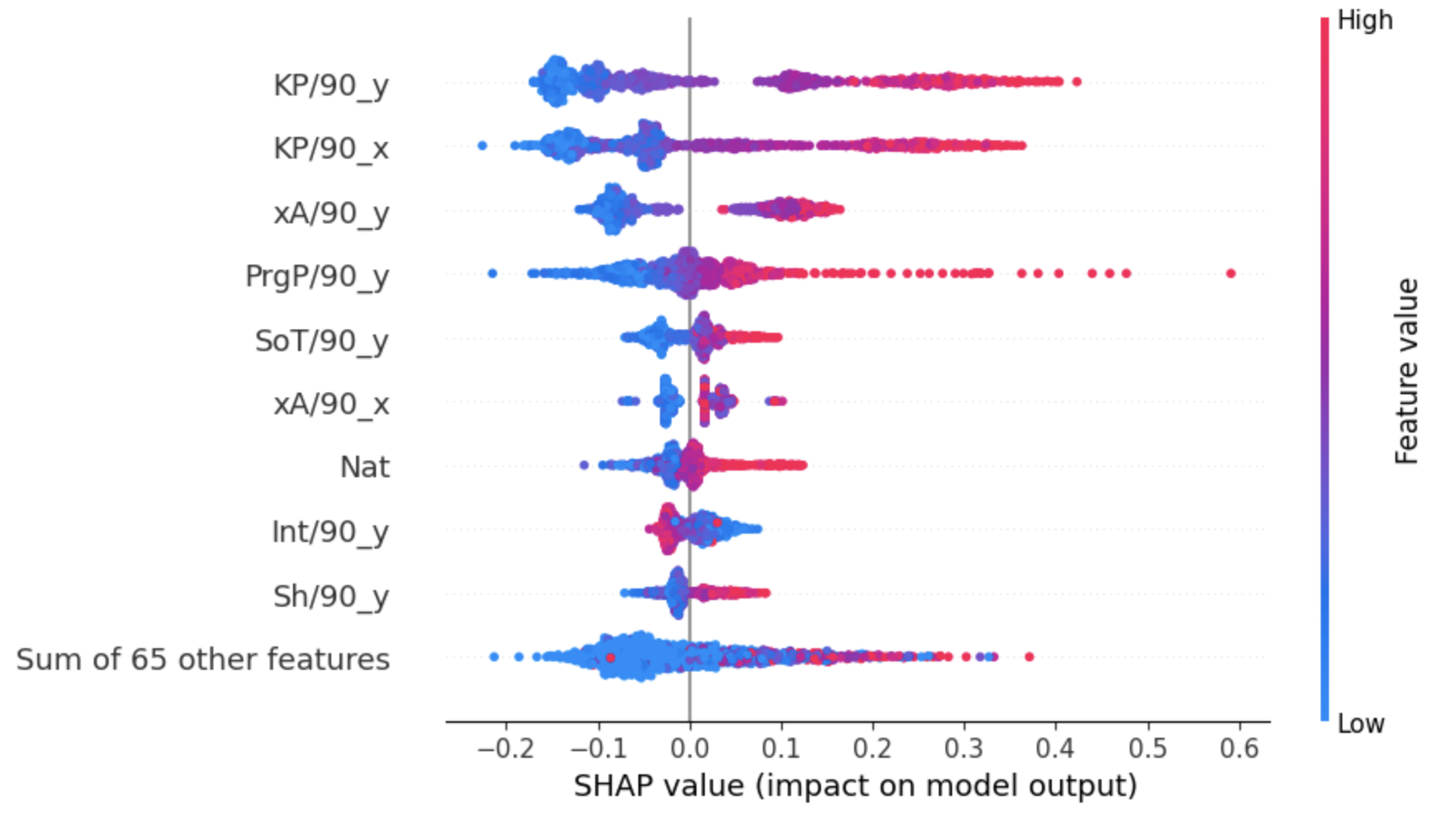
SHAP Analysis - Midfielders

Slide 8
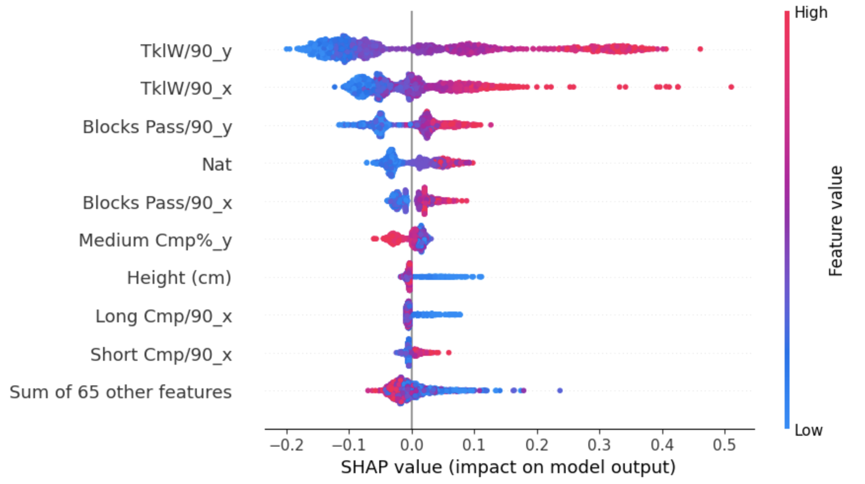
SHAP Analysis - Defenders

Slide 9
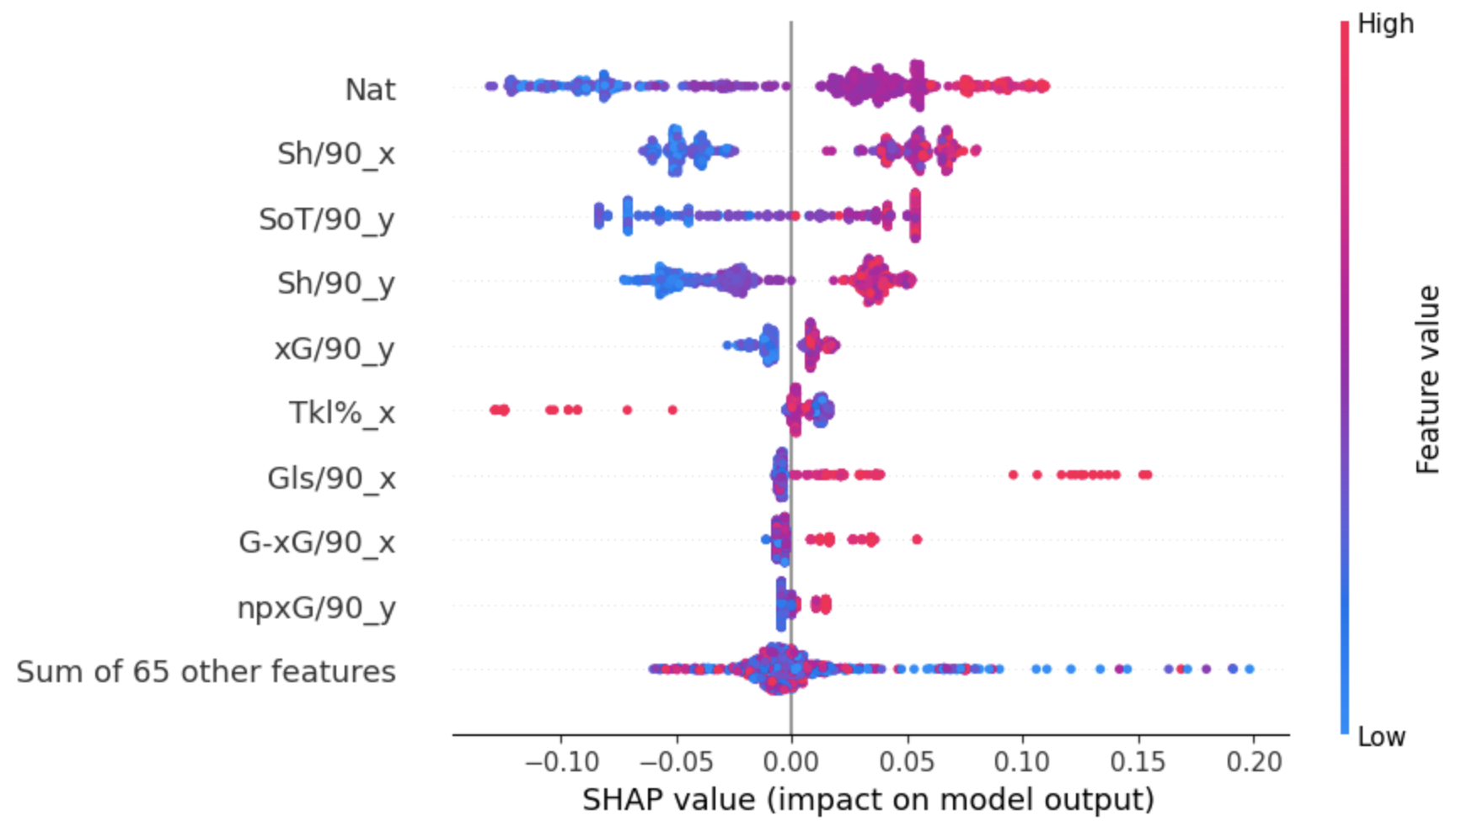
SHAP Analysis - Attackers
with Nationality feature

Slide 10
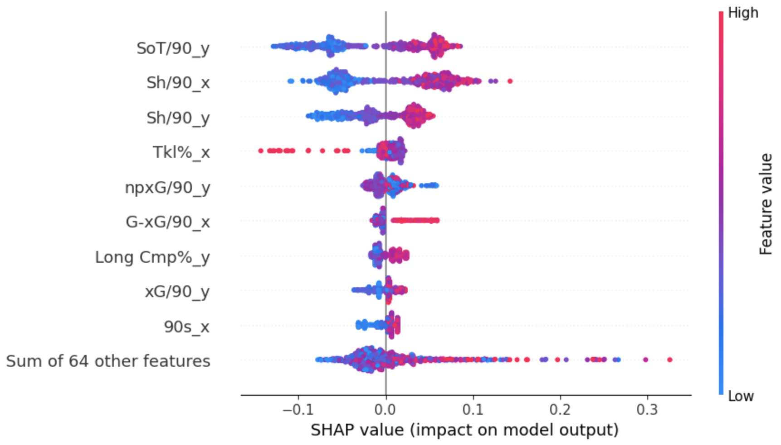
SHAP Analysis - Attackers
without Nationality feature

Slide 11
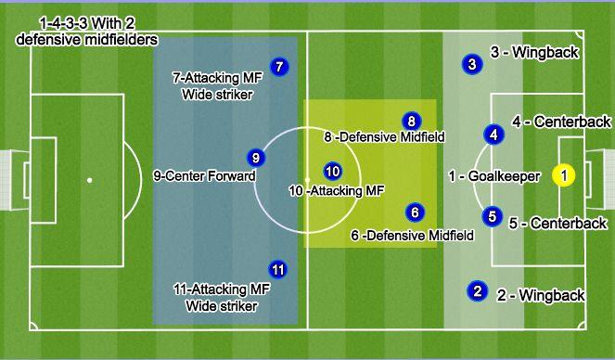
Future Work
Separate players into more role-specific groups (wingbacks, centerbacks, centermid, etc.)
Incorporate “new” players into datasets
Explanation Clustering Analysis to extract trends/patterns within specific clusters of players

